Slide 1
REPOSITORY PATTERN

Slide 2
REPOSITORY
Before going into repository design pattern lets first understand what is repository:
In generic terms repository simply means a place where things are or can be stored.
This term has wide array of use in computer science for example code repository.
We are all familiar with GITHUB. it’s a code repository

Slide 3
DEFINING REPOSITORY PATTERN
So now we have a idea of what repository means lets think how that is connected to software architecture:
Here we will have multiple sub systems.
Sub-systems must exchange data. This may be done in two ways:
Shared data is held in a central database or repository and may be accessed by all sub-systems;
Each sub-system maintains its own database and passes data explicitly to other sub-systems.
When large amounts of data are to be shared, the repository model of sharing is most commonly used as this is an efficient data sharing mechanism.
SO lets define repository pattern formally

Slide 4
—FORMAL DEFINITION
“A Repository mediates between the domain and data mapping layers, acting like an in-memory domain object collection. Client objects construct query specifications declaratively and submit them to Repository for satisfaction. Objects can be added to and removed from the Repository, as they can from a simple collection of objects, and the mapping code encapsulated by the Repository will carry out the appropriate operations behind the scenes.”

Slide 5
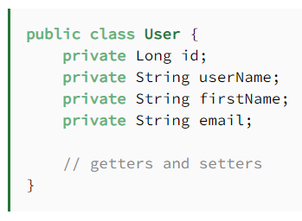
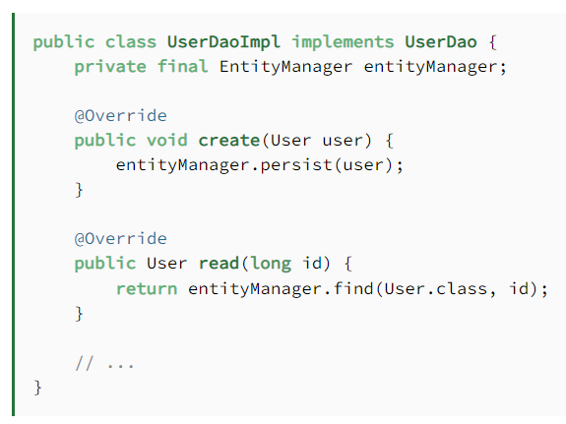
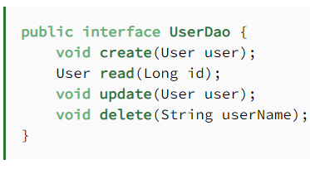
REPOSITORY PATTERN EXAMPLE

Slide 6
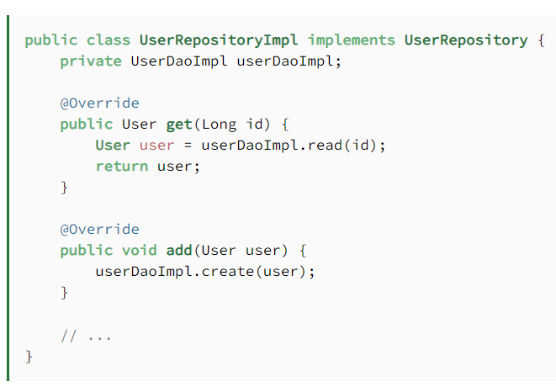
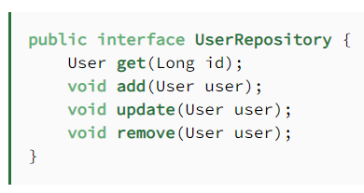
REPOSITORY PATTERN EXAMPLE

Slide 7
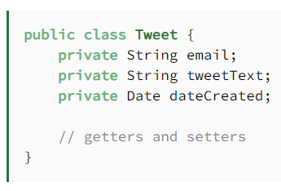
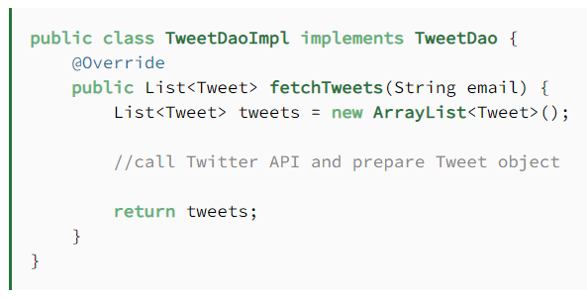
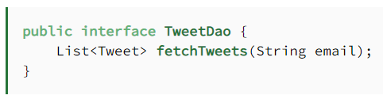
REPOSITORY PATTERN EXAMPLE

Slide 8
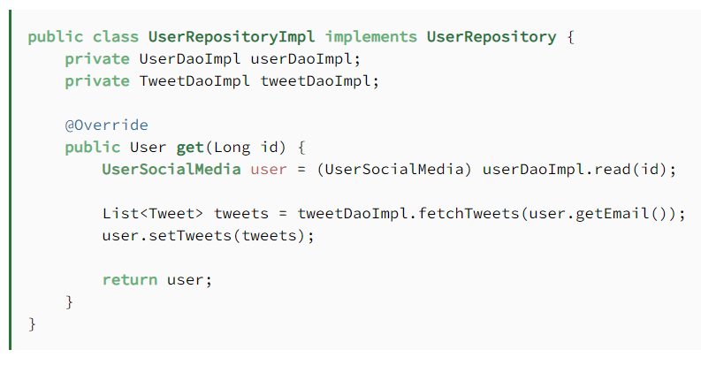
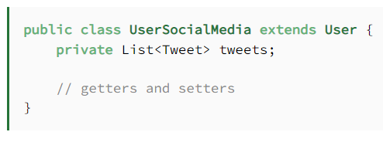
REPOSITORY PATTERN EXAMPLE
UserRepositoryImpl(…) UPDATED

Slide 9
Example Credits
https://www.baeldung.com/java-dao-vs-repository

